Slide 1

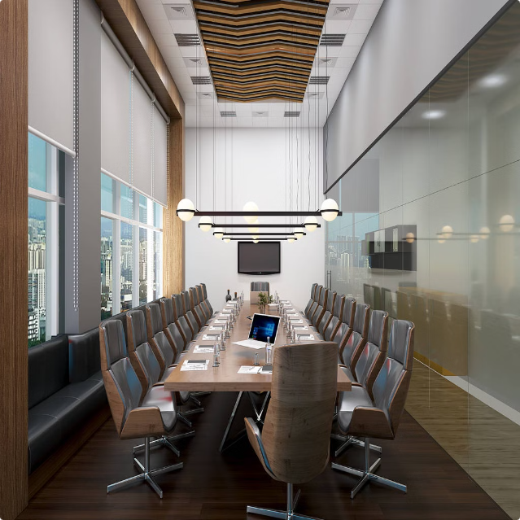
Automated Meeting-Room Booking System
Presented By -
Vansh Gupta
Rishiraj Biswas
Shruti Bhartia
Mokshit Lodha
Saurabh Bhandari
Sonali Kaingade
Manish Saravanan

Slide 2

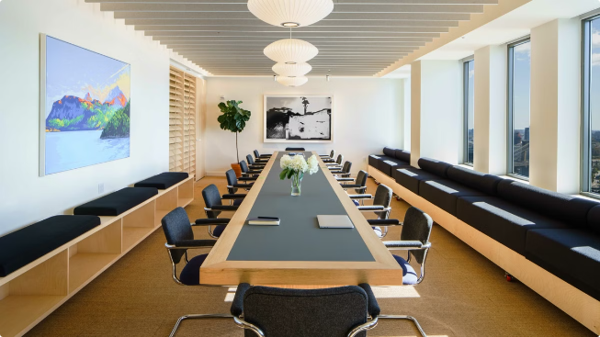
Project Scope
This presentation outlines the development of an innovative automated meeting room booking system, designed to streamline scheduling and optimize room usage.
Streamlined Booking
The system automates the meeting room booking process, eliminating manual requests and confirmations.
User-Centric Design
The system caters to diverse user needs with roles tailored for Admin, Manager, and Member users.
Comprehensive Features
Key functionalities include searching and booking rooms, managing credits, and viewing meeting schedules.

Slide 3


User Roles and Permissions
Role
Permissions
Admin
Create, configure, and manage meeting rooms, control schedules.
Manager
Book rooms, pay with credits, manage and view meetings.
Member
View meeting schedules.

Slide 4

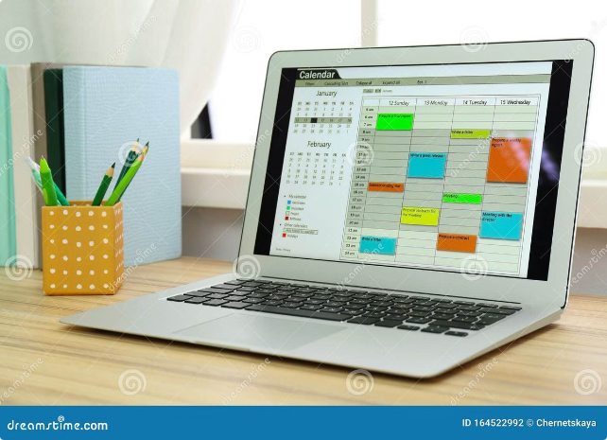
Meeting Room Booking Features
1
Smart Room Selection
Book rooms based on desired seating capacity and amenities like projectors and WiFi.
2
Meeting Type Requirements
Ensure essential amenities are automatically selected based on meeting type, such as whiteboards for training sessions.
3
User-Friendly Interface
The booking process is intuitive and streamlined, making it easy to find and reserve the right room.

Slide 5
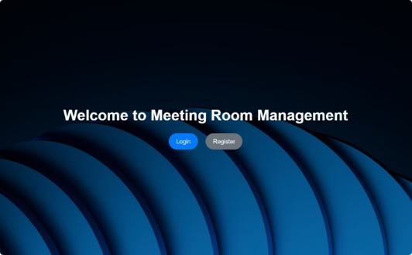
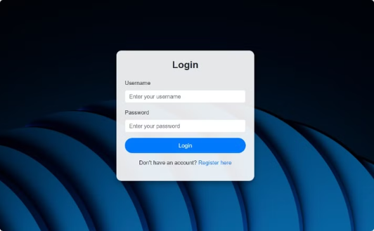
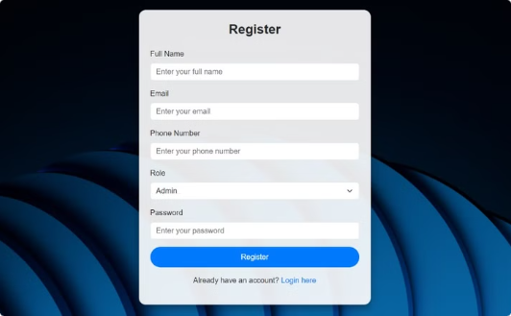
Welcome, Login and Registration Pages
Welcome Dashboard
Login Dashboard
Register Dashboard
Provides the user option to either Login or Register
This page provides the user to login by providing the credentials - username and password
This page allows user to register by providing some details.

Slide 6
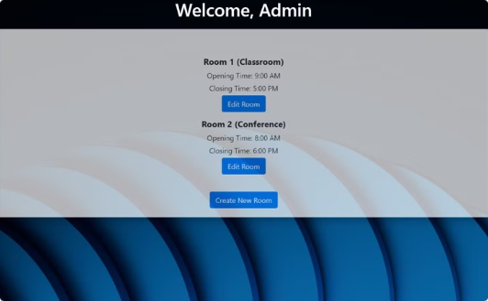
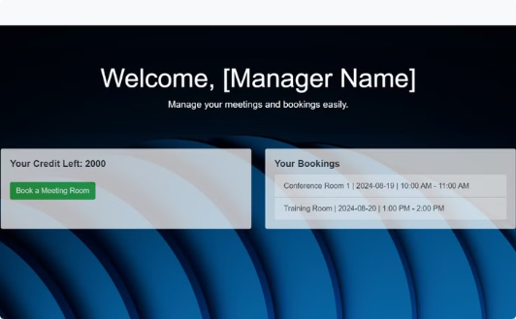
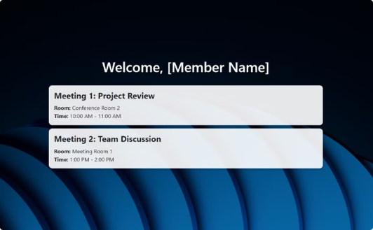
Admin, Manager and Member Pages
Admin Dashboard
Manager Dashboard
Member Dashboard
The admin page provides comprehensive control over meeting room creation, editing, and management.
The manager page facilitates meeting organization, booking, and management, with access to room availability and credits.
The member page allows the mebers to view the organized meeting and the meeting rooms booked.

Slide 7
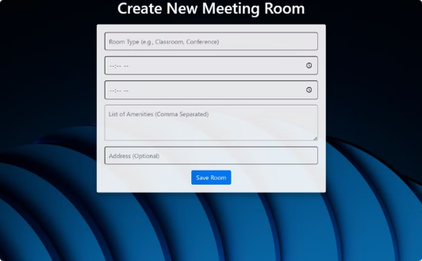
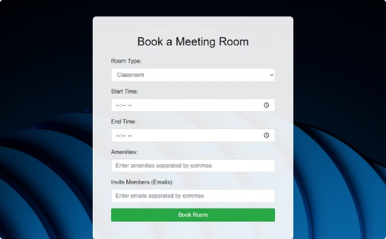
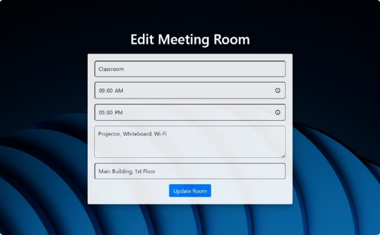
Create, Book and Edit Meeting Room Pages
Create Dashboard
Book Dashboard
Edit Dashboard
This page allows managers to create a meeting room by providing the necessary details.
This page allows the managers to book a meeting room by providing details asuch as ameneties, time, etc.
This page facilitates the managers to edit a meeting room after booking it.

Slide 8




User Interface Design
Login Page
Securely authenticates users based on their assigned roles.
User Import
Allows for efficient user onboarding by importing user data from an XML file.
Admin Pages
Provides tools for creating and editing meeting rooms, ensuring flexibility and control.
Manager Pages
Streamlines meeting organization and room booking, empowering managers to efficiently schedule events.

Slide 9






Key Learning and Tools Used
Role-Based Access Control
Implemented robust security measures to ensure only authorized users can access specific functionalities.
Automated Credit Management
Developed a sophisticated system to track and manage credits, ensuring seamless usage and accounting.
Backend Technologies
Leveraged SQL for data storage and background jobs to automate credit resets.
Frontend Development
Utilized HTML/CSS for front-end design and JavaScript for interactive elements.

Slide 10


Conclusion
Key Benefits
1
The automated meeting room booking system streamlines scheduling, reduces administrative overhead, and optimizes room utilization.
2
Future Enhancements
Planned enhancements include notifications for upcoming meetings, expanded reporting features, and more granular role permissions.
Conclusion
3
The system successfully addresses the challenges of managing meeting room bookings and contributes to improved efficiency and productivity.

Slide 11


Thank You

